Slide 1
Software Engineering
Lecture 6

Slide 2
Agenda
The software requirements specification

Slide 3
Software Requirements Specification
The software requirements specification (sometimes called the software requirements document or SRS) is an official statement of what the system developer
It may include both the user requirements for a system and a detailed specification of the system requirements.
Sometimes the user and system requirements are integrated into a single description.
Requirements documents are essential when systems are outsourced for development, when different teams develop different parts of the system, and when a detailed analysis of the requirements is mandatory.
In other circumstances, such as software product or business system development, a detailed requirements document may not be needed.

Slide 4
Software Requirements Specification
Agile methods argue that requirements change so rapidly that a requirements document is out of date as soon as it is written, so the effort is largely wasted.
Rather than a formal document, agile approaches often collect user requirements incrementally and write these on cards or whiteboards as short user stories.
For business systems where requirements are unstable, this approach is a good one, but it is still useful to write a short supporting document that defines the business and dependability requirements for the system

Slide 5
Users of a Requirements Document
The requirements document has a diverse set of users, ranging from the senior management of the organization that is paying for the system to the engineers responsible for developing the software
Following are the possible users of the document and how they use it.
System Customers
Managers
System Engineers
System test Engineers
System maintenance Engineers
The diversity of possible users means that the requirements document has to be a compromise.
It has to describe the requirements for customers, define the requirements in precise detail for developers and testers, as well as include information about future system evolution.

Slide 6
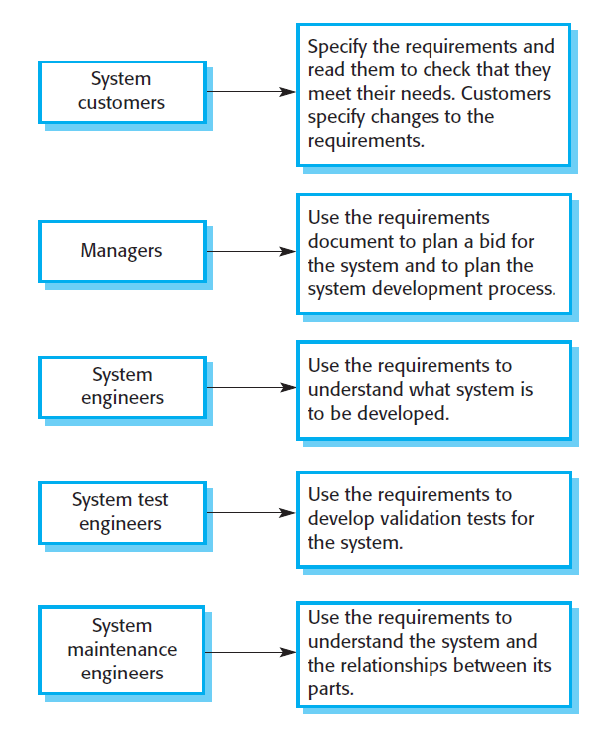
Users of a Requirements Document

Slide 7
Details included in SRS
The level of detail that you should include in a requirements document depends on the type of system that is being developed and the development process used.
Critical systems need detailed requirements because safety and security have to be analyzed in detail to find possible requirements errors.
When the system is to be developed by a separate company (e.g., through outsourcing), the system specifications need to be detailed and precise.
If an in-house, iterative development process is used, the requirements document can be less detailed. Details can be added to the requirements and ambiguities resolved during the development of the system.

Slide 8
Requirements document standards
IEEE/ANSI 830-1998 (IEEE, 1998)
BS 6719: 1986
European Space Agency Standards
(ESA PSS-05-0, Jan 1987)
US DoD-Std-7935A
NASA Standard
Canadian Standard (Z242.15.4-1979)
Vlore Standard

Slide 9
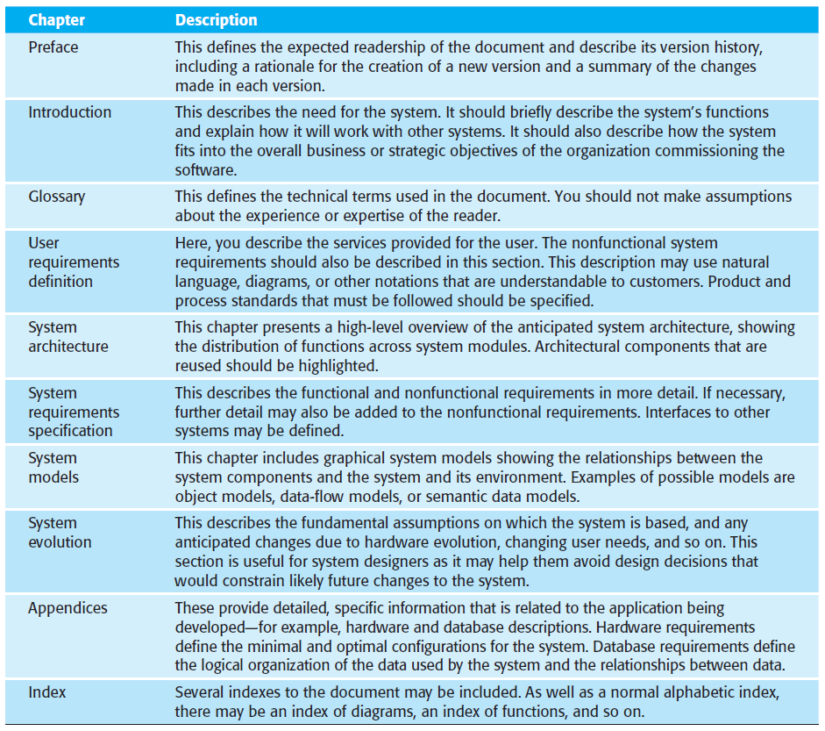
The structure of a requirements document

Slide 10
The structure of a requirements document
Naturally, the information included in a requirements document depends on the type of software being developed and the approach to development that is to be used.
A requirements document with a structure like that shown previous slide might be produced for a complex engineering system that includes hardware and software developed by different companies.
The requirements document is likely to belong and detailed. It is therefore important that a comprehensive table of contents and document index be included so that readers can easily find the information they need.
By contrast, the requirements document for an in-house software product will leave out many of the detailed chapters suggested above. The focus will be on defining the user requirements and high-level, nonfunctional system requirements.
The system designers and programmers use their judgment to decide how to meet the outline user requirements for the system.

Slide 11
Why SRS is Important?
The SRS is an essential document for all development activities from the initiation to the completion of the project because it reflects the most relevant information that the software development team needs to understand and implement the project.
The more precise and detailed the requirements, the easier it will be for developers to implement their tasks. An effective SRS will help in:
Provide necessary information to accurately estimate the project costs, risks, and delivery timeline.
Give the team a clear roadmap to follow and achieve project objectives.
Ensure information transparency across teams and parties.
Serve as a source of information for user acceptance testing.
Build a stable foundation for future customization and enhancement.

Slide 12
Why SRS is Important?
It’s used to provide critical information to multiple teams, development, quality assurance, operations, and maintenance. This keeps everyone on the same page.
“Partner” with the customer in developing the software requirements
The SRS is your contract with the customer.
It is also an additional source of information. If the customer is unhappy, you will hear about it.
Inconsistent and incomplete requirements are the most frequent causes of system problems.

Slide 13
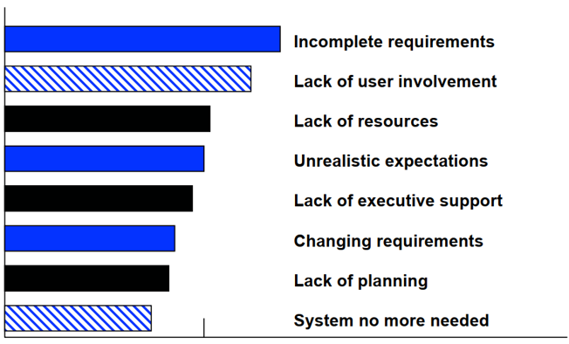
Why SRS is Important?

Slide 14
Need for SRS
SRS provides a reference for validation of the final product.
Streamlining the development process.
High-quality SRS essential for high-quality software.
Good SRS reduces the development cost.
Cost of fixing errors in requirements, design, coding, acceptance testing, and operation are 2, 5, 15, 50, and 150 person-months.

Slide 15
Specification Techniques
Informal Specifications
Textual descriptions and informal diagrams are easy for understanding
These specifications are often ambiguous, over flexible, imprecise, and lengthy
Semi-formal (graphical, tabular)
Most of the semiformal specifications are based on UML
Formal Specifications
Formal specification forces a very details analysis of the system requirements at an early stage. Correcting errors at this stage is cheaper.
Algebraic approach
The system is specified in terms of its operations and their relationships
Model-based approach
The system is specified in terms of a state model that is constructed using mathematical constructs such as sets and sequences.

Slide 16
Advantages of High-Quality SRS
Structures and formalizes the project’s ideas.
Original requirements may be fragmented, inconsistent, or incomplete. When preparing an SRS, BAs structure requirements, identify gaps or unclear demands and elicit requirements from stakeholders.
Creates agreement between all parties.
An SRS contains all requirements that the client and the development company have discussed and agreed upon. If either party has doubts about the agreement, they can simply check the SRS.
Clearly defines the project scope.
An SRS outlines the priority of the requirements, which helps the development team plan project iterations, releases, and the scope of work.

Slide 17
Advantages of High-Quality SRS
Allows for precise schedule and budget estimates.
The development team can analyze SRS contents to draw up the budget and accurately estimate the project.
Provides the basis for software testing.
Quality assurance (QA) engineers test software against the SRS to determine if the developed solution complies with the client’s requirements or not.
Simplifies future software improvements.
If the client needs to upgrade the developed software, it’s easier for a new contractor to study it by analyzing the SRS than by investigating or reverse-engineering the software itself.

Slide 18
Risks of Developing a Low-Quality SRS
Inaccurate schedule and budget estimates.
Without a clear and complete requirements specification, a development company can’t provide accurate estimates of a project’s duration and budget, which might result in financial losses for the client.
Developed software doesn’t meet all the client’s needs.
An overcomplicated or ambiguous SRS can confuse developers instead of guiding them. Developers may misunderstand the stakeholder’s requirements and the client may end up with software that doesn’t meet their needs.
Communication overhead for all project participants.
A low-quality SRS doesn’t provide the project team with complete requirements. In this case, project BAs, developers, and stakeholders will have to hold many meetings to negotiate and clarify each next step.

Slide 19
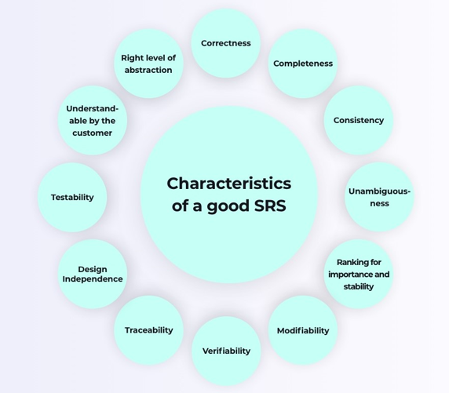
Characteristics of a good SRS

Slide 20
Characteristics of a good SRS
Complete
Description of all major requirements relating to functionality, performance, etc.
Consistent
A software requirement specification is consistent if none of the requirements conflict
Traceable
Origin and all references are available
Unambiguous
Having two or more meanings
Verifiable
All requirements are verifiable
Modifiable
Should be flexible for modifications

Slide 21
What not to include in SRS
Project development plans
Staffing, Methods, Tools, etc.
Product quality assurance plans
Configuration Management, Verification & Validation
Design information
Requirements and designs have different audiences

Slide 22
Challenges of SRS development
Creating a high-quality software requirements specification in software engineering is challenging even for an experienced requirement engineer or business analyst.
Extensive and overcomplicated requirements
Constant changes in the requirements
Conflicting requirements
Misunderstanding of the desired functionality

Slide 23
Questions?

